Slide 1
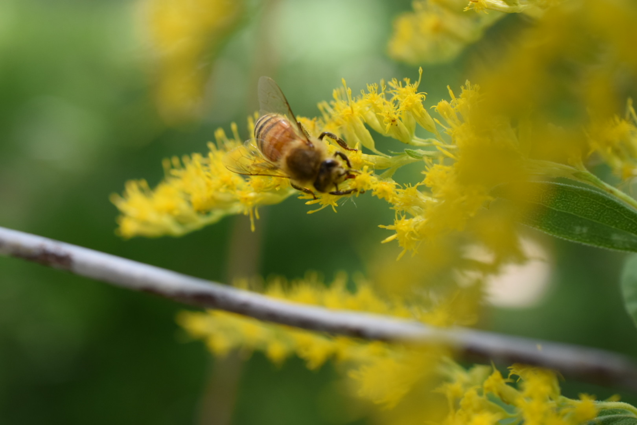
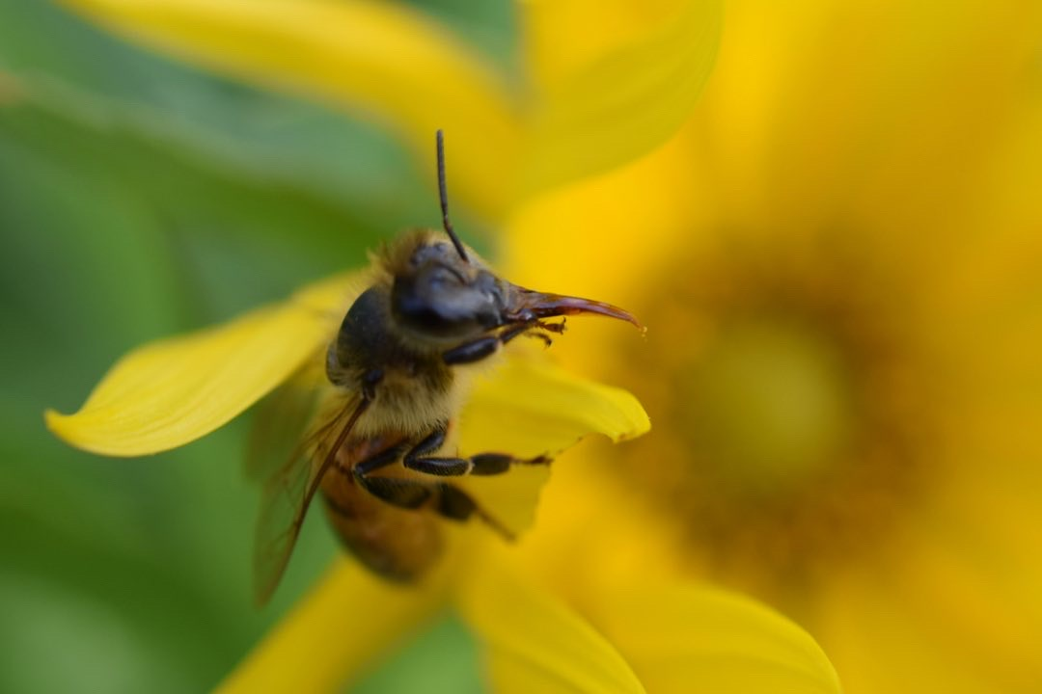
Characterizing Honeybee Colony Dynamics Using Data Analytics: Preliminary Results
Kurt B. Ferreira, Ph.D
ABQBeeks Meeting
13 April 2023

Slide 2
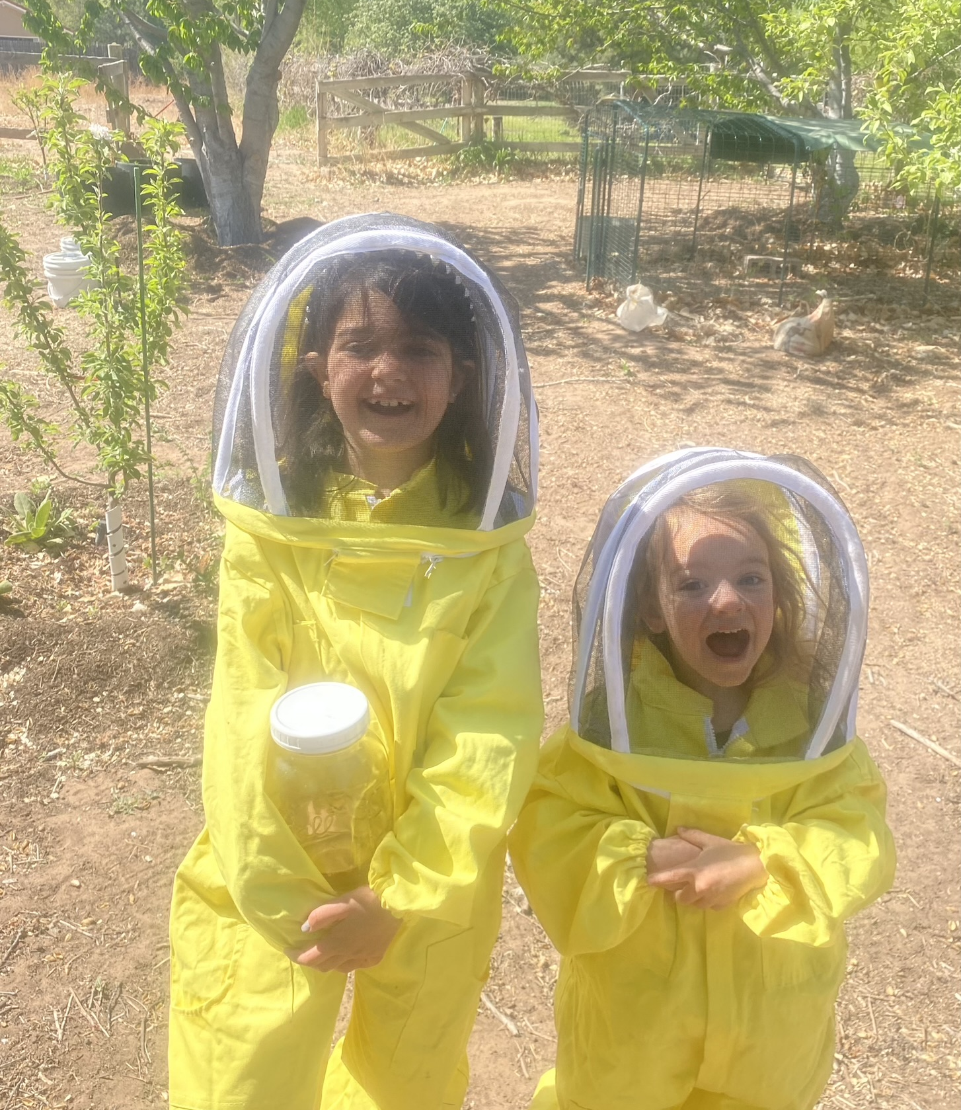
Who am I? Why am I Here?
Beekeeper since ~2018
~12 Hives in the Los Ranchos area
Hive styles: Langs, Layens and Top Bars
Researcher at Sandia National Labs
(Sometimes) Professor @ UNM in CS dept.
Research Area: Resilient Supercomputing Systems
(Acting) President, NMBKA
2nd Year NMBKA Cbeeks Student

Slide 3
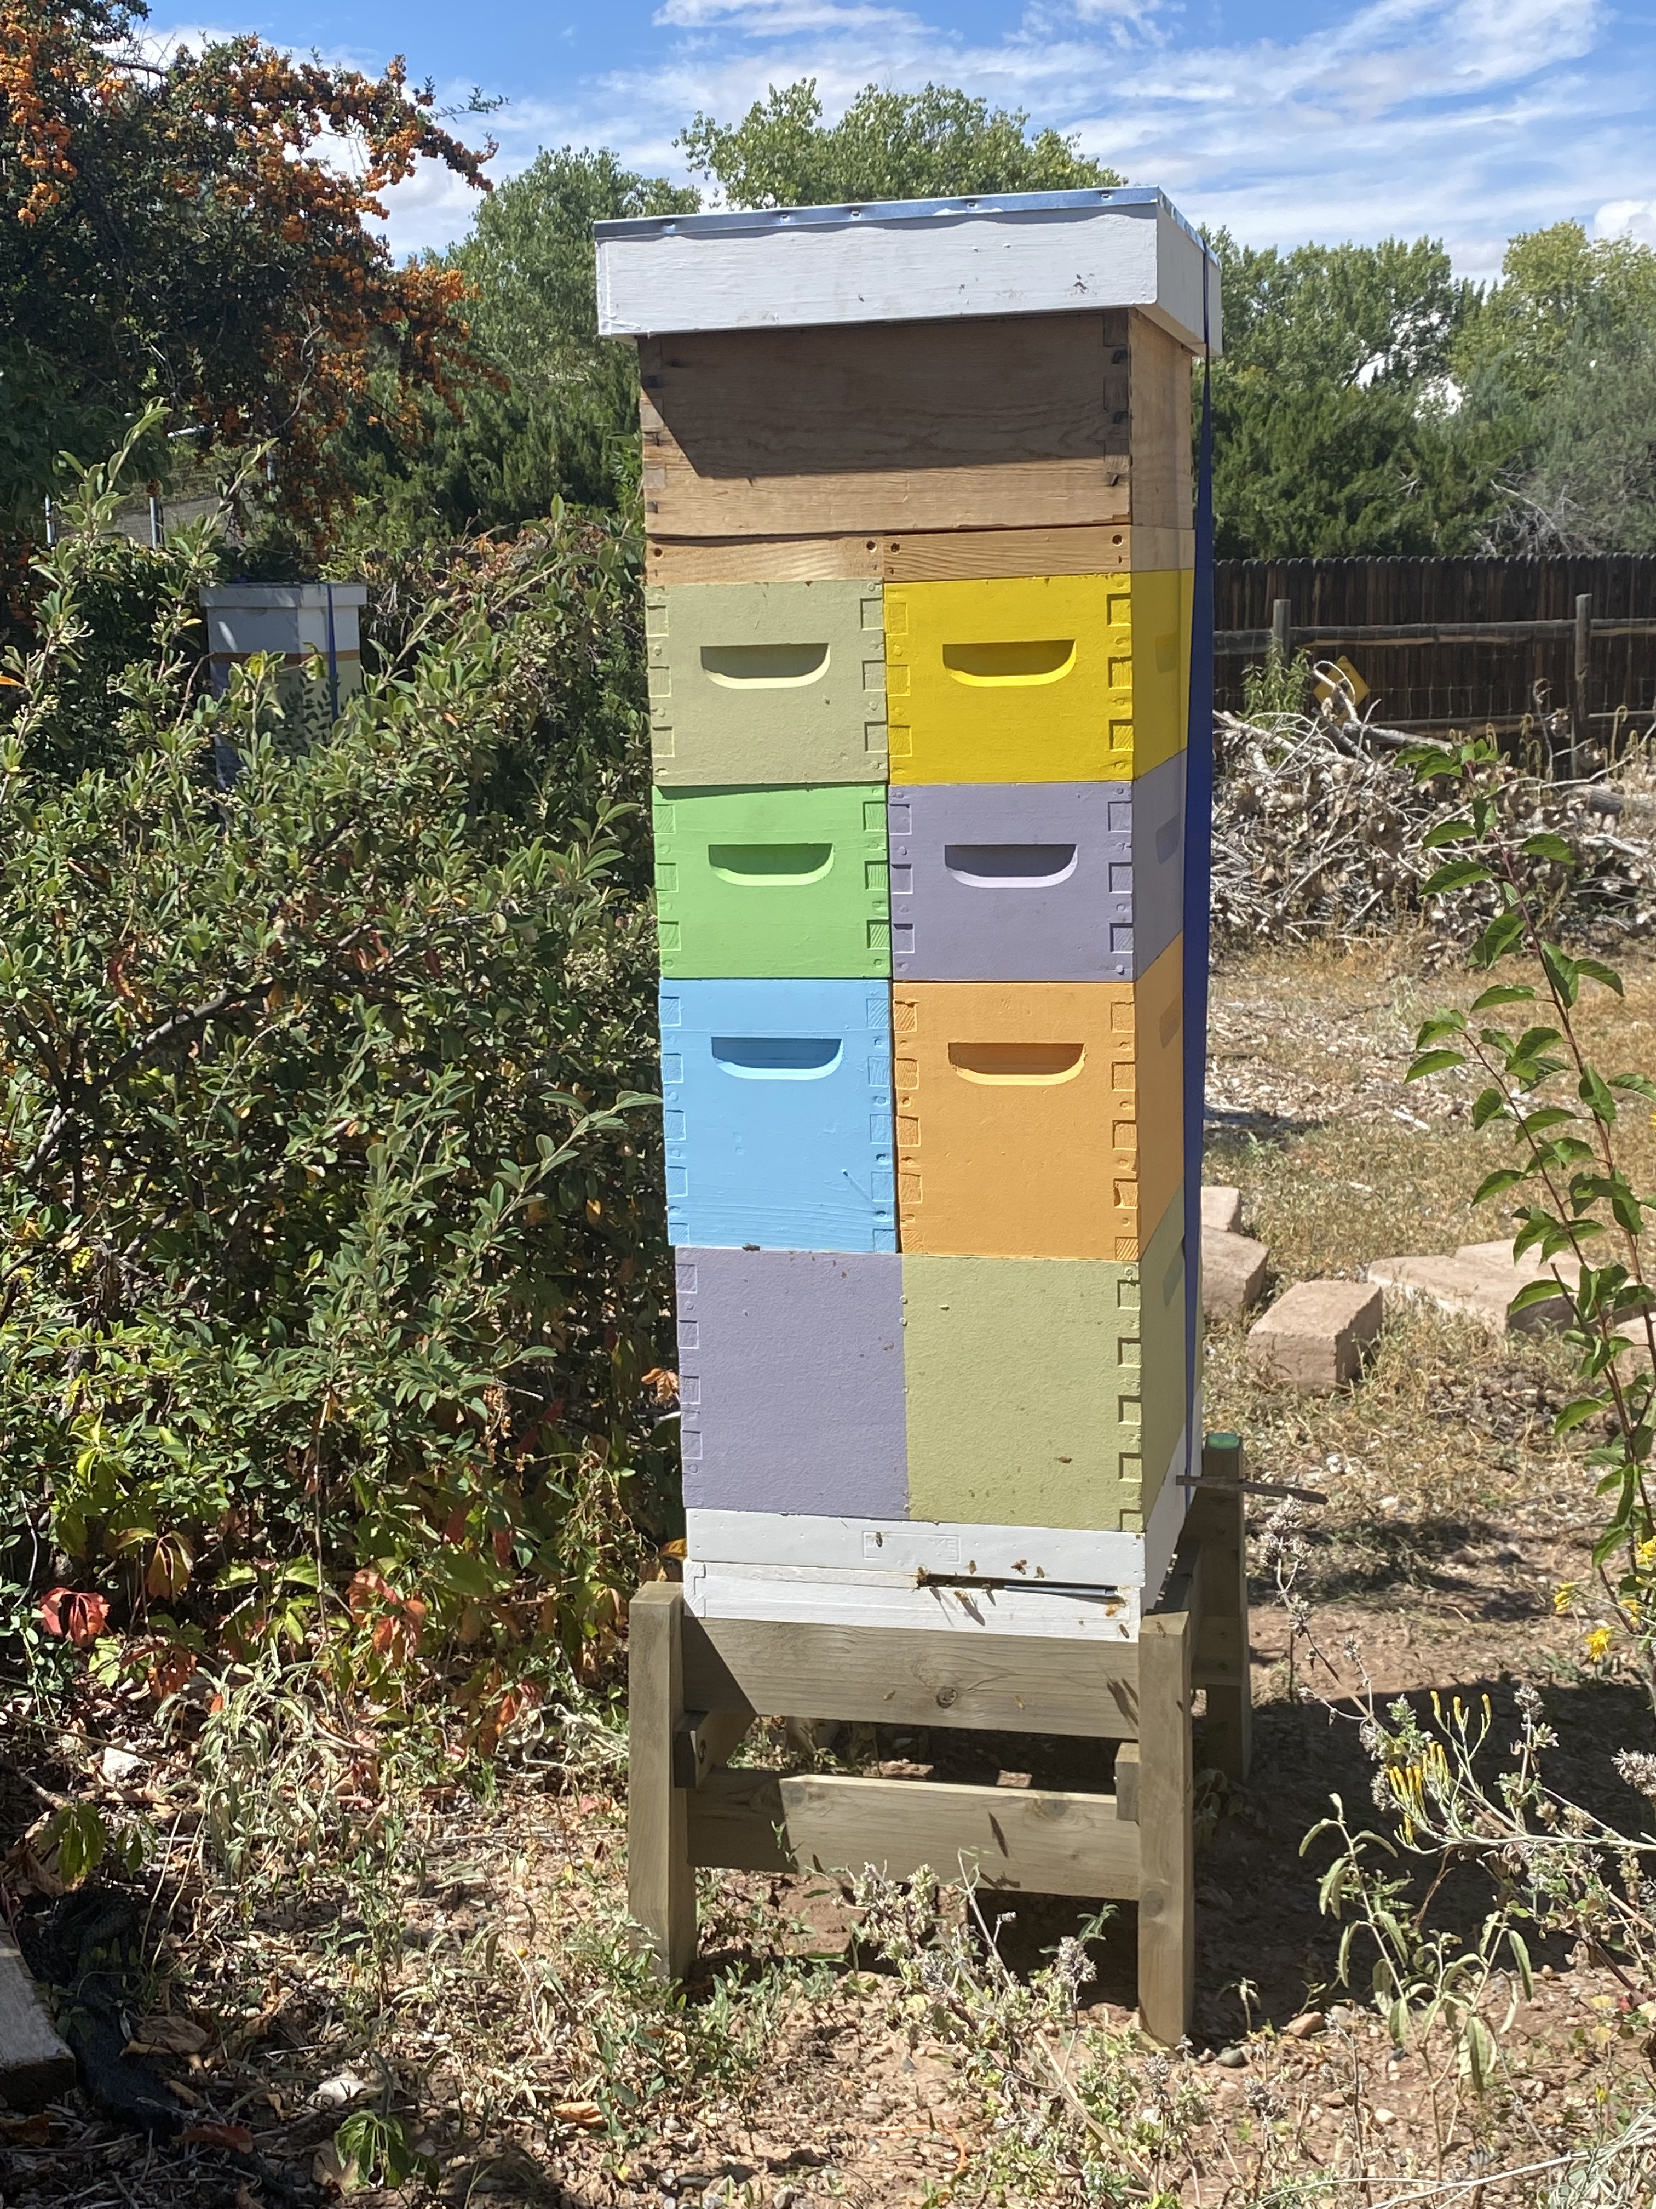
Goals
Characterize colony dynamics using hive sensor devices
Answer questions on:
Winter honey consumption
Strength of flow
Forager field force size
Robbing events
Swarm prediction
Utilize standard “big data” analytics methods
Ultimate goal, open-source data from “sentinel hives” throughout the area for all beekeepers to utilize

Slide 4
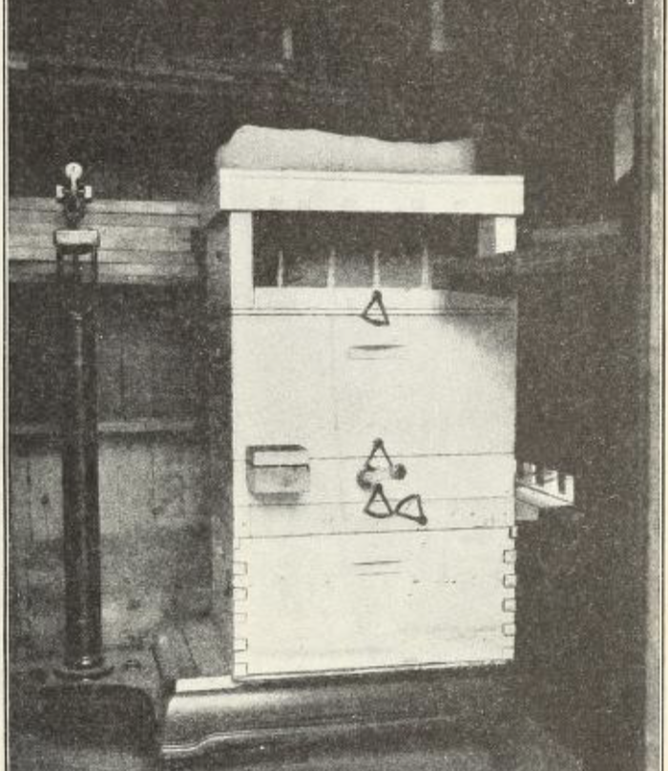
History of Hive Monitoring
Gates – 1914
Monitored temperature and weight for a year
Quantified winter honey consumption
Demonstrated winter brooding though temperature tracking
Hambleton –1925
Correlated ambient weather variables to hive weight
Ambient temperature
Relative humidity
Hours of sunshine

Slide 5
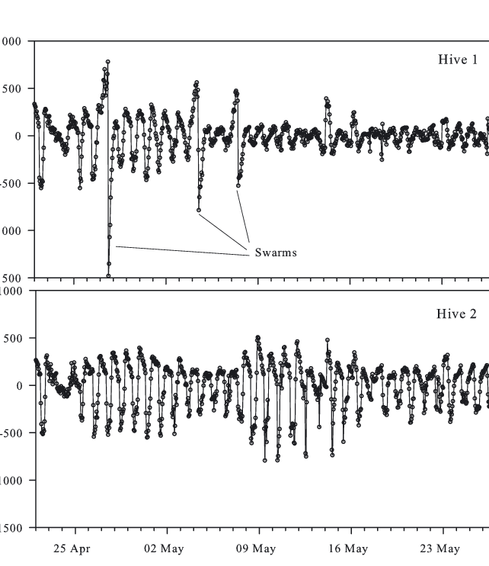
History of Hive Monitoring (cont’d)
Buchmann and Thoenes --1990
Continuous weight monitoring
Precision scale linked to a computer
Recorded data every 15 min for 1 month
Meikle et al. -- 2006, 2008
Recorded weight hourly over 16 months
Showed the effects of swarming on daily detrended data
Detected empty wooden hive daily weight change due to moisture changes in wooden hive bodies

Slide 6







Hive Monitoring in the IoT Era
Numerous hobbyist devices
Monitor key hive metrics
External/internal temperature and humidity
Hive weight
Entrance/Exit counters (gates and radar)
Frequency/amplitude of colony members
Vibration/Hive movement

Slide 7
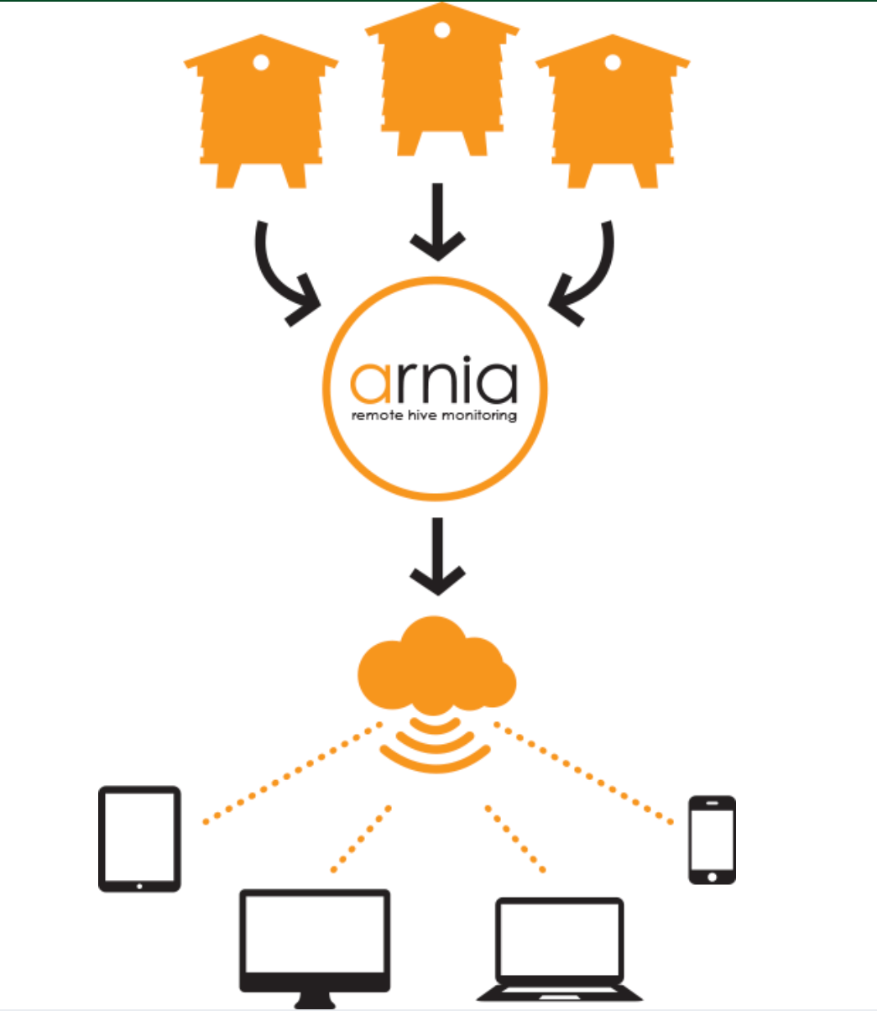

Hive Monitoring in the IoT Era (cont’d)
Cloud Storage
Careful, many user agreements state you do not own your data!
Alert notification for urgent events
Swarming/Absconding
Queen loss
Robbing
Problem: Analysis methodology questionable
Methodologies not public or peer reviewed
Lots of false positives
Bi-weekly queen loss notification
Dead/Swarm notifications
Remote
Monitoring

Slide 8





Hive Monitoring Goals
Create analysis toolkit
Process data using standard machine learning/data analytics techniques
Classify critical events, correlating sensor data to observed conditions
Compare against available vendor utilities, where possible
Make data/analysis available to local beekeepers for analysis
Toolkit details
Python: SciPy NumPy, pandas and matplotlib
Code: https://github.com/NMBKA-Cbeeks/colony_trending.git
Sensor Data (to appear): https://doi.org/10.5281/zenodo.7212455

Slide 9
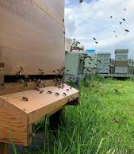
Hive Monitoring Questions?
Winter/dearth honey consumption – more accurate measure of honey needed
Flow strength – when to add/pull supers
Forager field force – how many bees are out flying?
Robbing
Detection
Rate of honey loss/gain
Swarming
Detection
Quantifying honey/bee losses

Slide 10
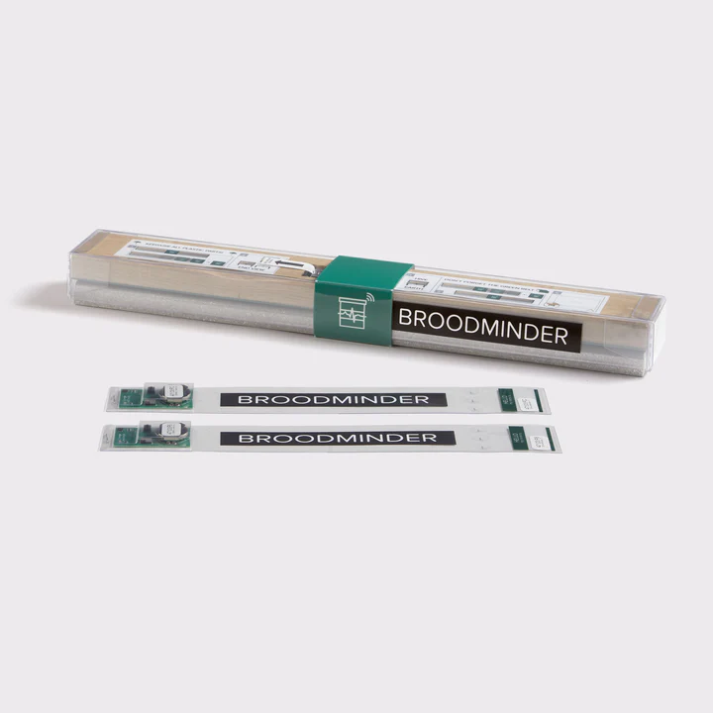
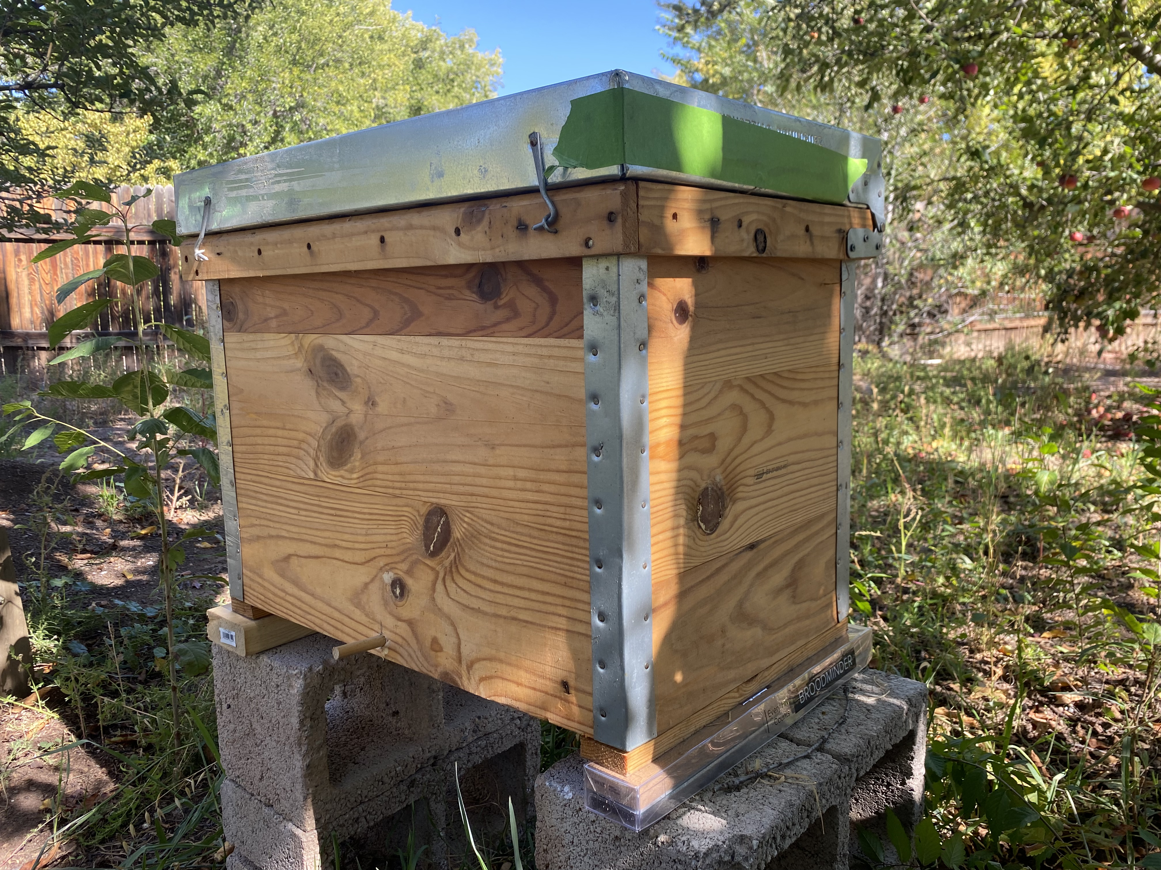
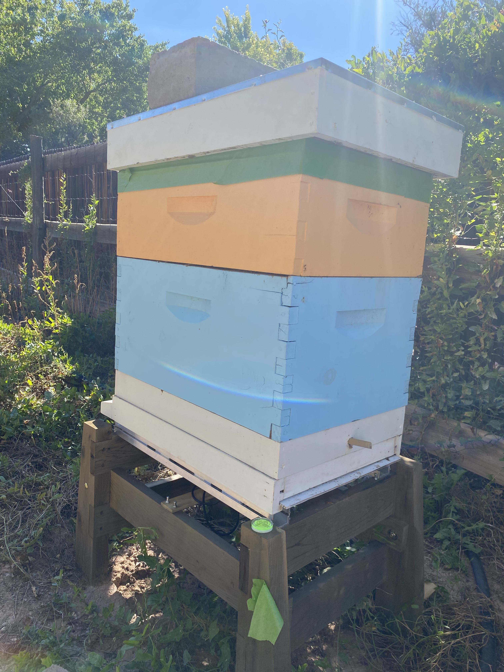
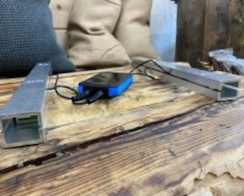
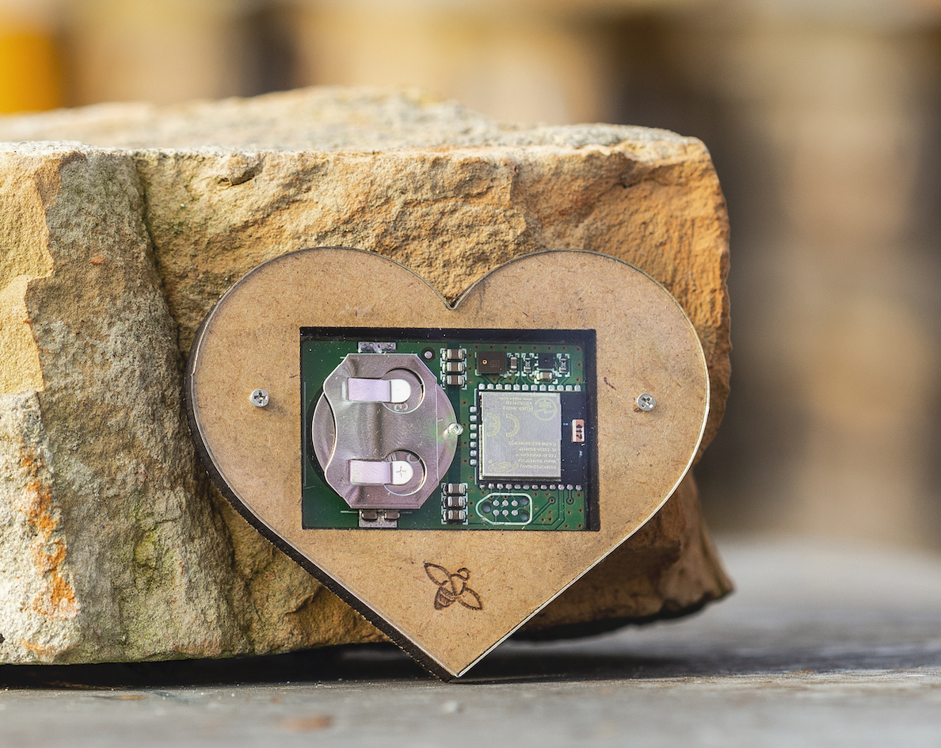
Monitoring Hardware
Broodminder
Scale under hive
Temp/Humidity sensor – inside the hive
14 frame Layens hive
Carniolans
Bee Hive Monitoring, USA
Scale under hive
Hive Heart – temperature, humidity, frequency and audio recordings
8-frame Langstroth hive
Carniolans
Bee Hive Monitoring USA

Slide 11
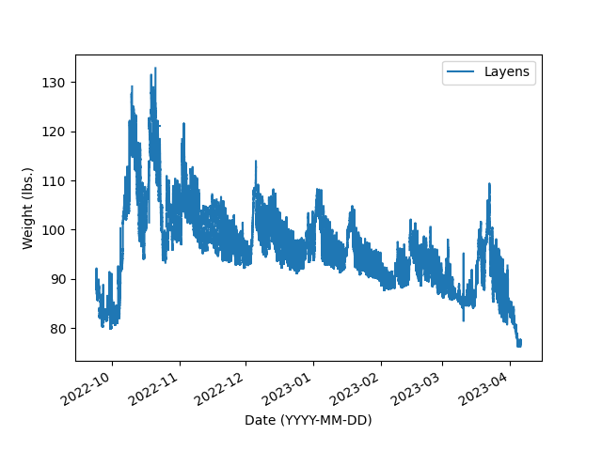
Hive Weight: Initial Analysis
Build-up
Overwintering
7 months of weight data from a Layens-style hive
Two significant trends:
Build-up
Overwintering

Slide 12
“Detrending” Data
Two components in weight data
Daily trend
Trend over dataset
Daily trend
Largely due to forager force departure and return and temperature changes
Termed “seasonal trend”
Use deconvolution methods to separate
Dataset trend
Largely due to the colony drying, consuming and acquiring nectar as well bee birth and death
Separate by generating a mathematical model

Slide 13
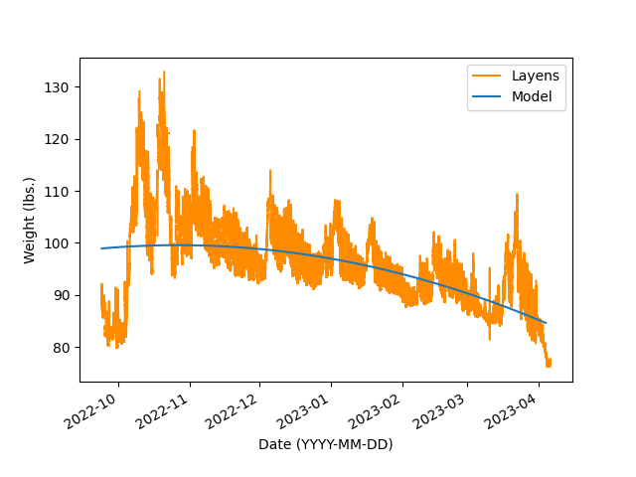
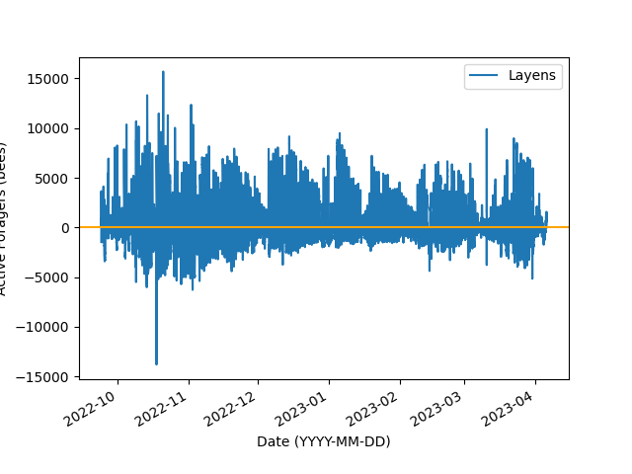
“Detrended” Data
Assumptions:
Assumes bee weights 0.11 grams
Ignores drone weight (0.2 grams)
Ignores diurnal weight changes due to water absorption/evaporation in wood or precipitation
Does not account for bee death
Model changes to account for above, TBD

Slide 14
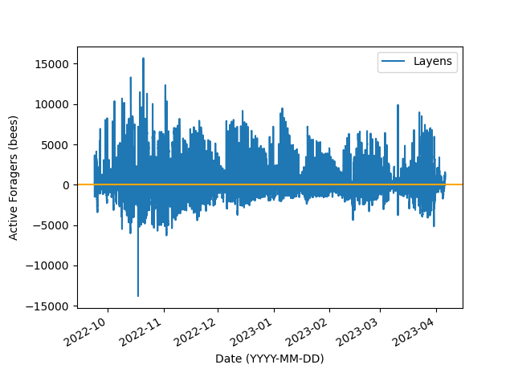
Active Foragers
Field force peaks at ~15K bees
Possibility of undercounting foragers as drones weigh twice that of workers
Dips below still unexplained, likely due to assumptions

Slide 15
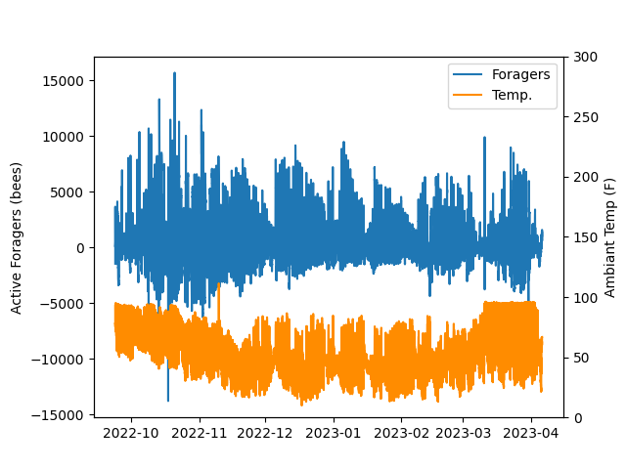
Active Foragers Calculation – Temperature Compensation?
Claim: scale is temperature compensated
Expected: forager count is highly correlated with temp.
Unexpected: correlated with larger temperature ranges

Slide 16
How much honey to leave for winter?
Interval Considered
Use generated model to determine honey consumed
Use time outside growing interval for ABQ (~Oct 1 to present)
Conservative “carnie” colony, with significant top insulation.
0.07 lbs / day => 17 lbs

Slide 17
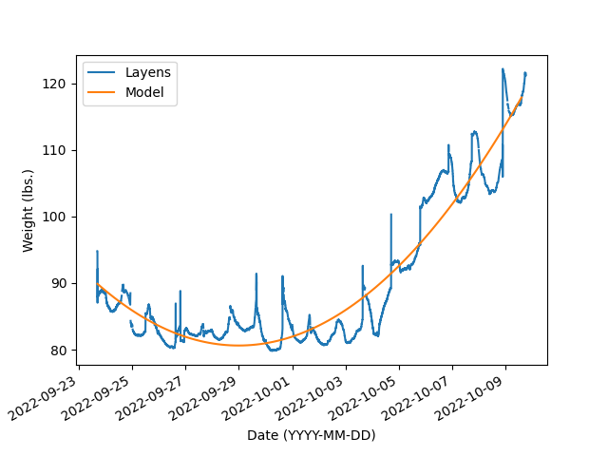
How much honey can bees collect from robbing?
Robbing event
Significant robbing event observed 10/04/2022 – 10/10/2022
Use simple polynomial regression
Acquisition during robbing event: 5.46lbs / day

Slide 18
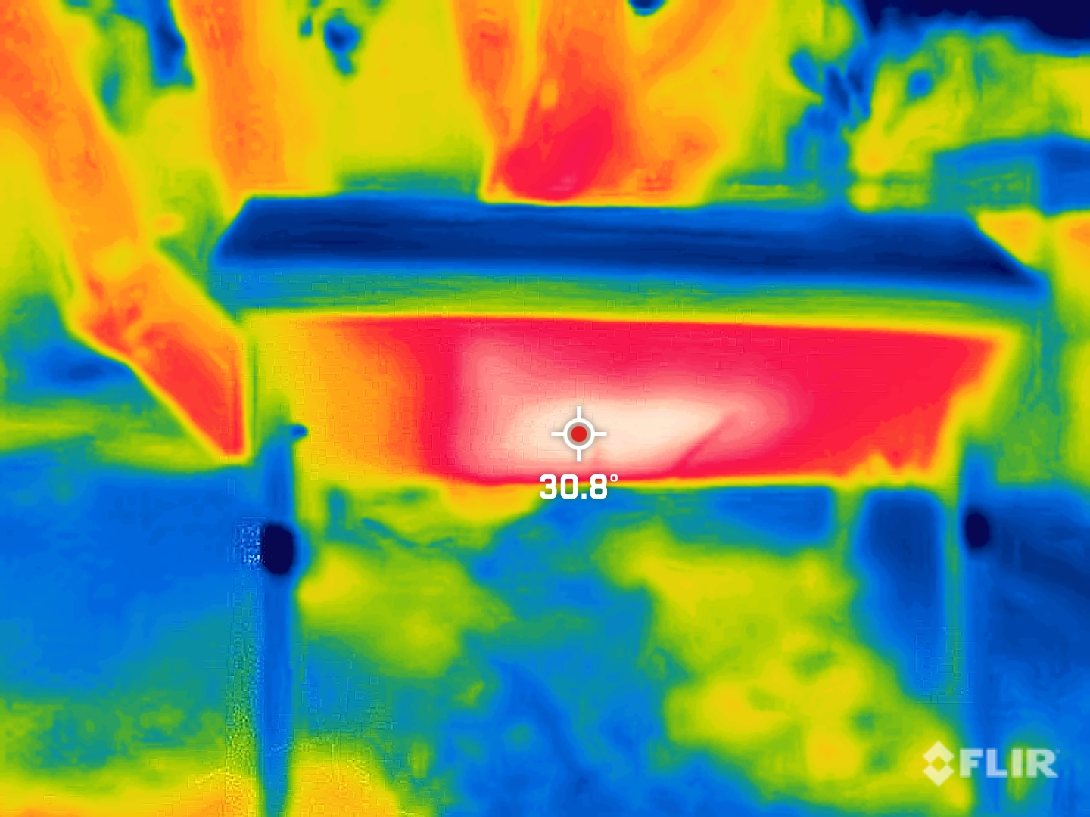
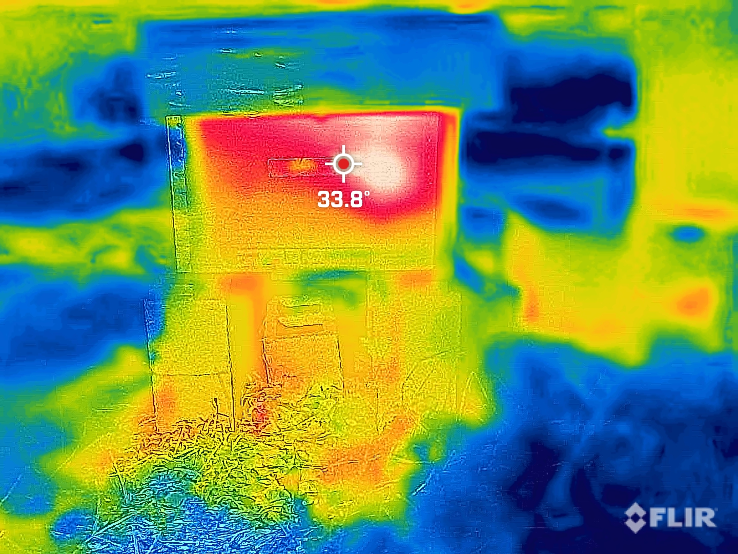
Ongoing Work
Complete year of data needed for statistically significant results
Additional colonies with different genetics
Additional hive styles and insulation.
Correlation with external metrics (precipitation, sunshine hours, internal/external temperature, etc.)
Correlation with other observation techniques (IR)
Comparison to vendor analytics
Open-source the data for comparison

Slide 19
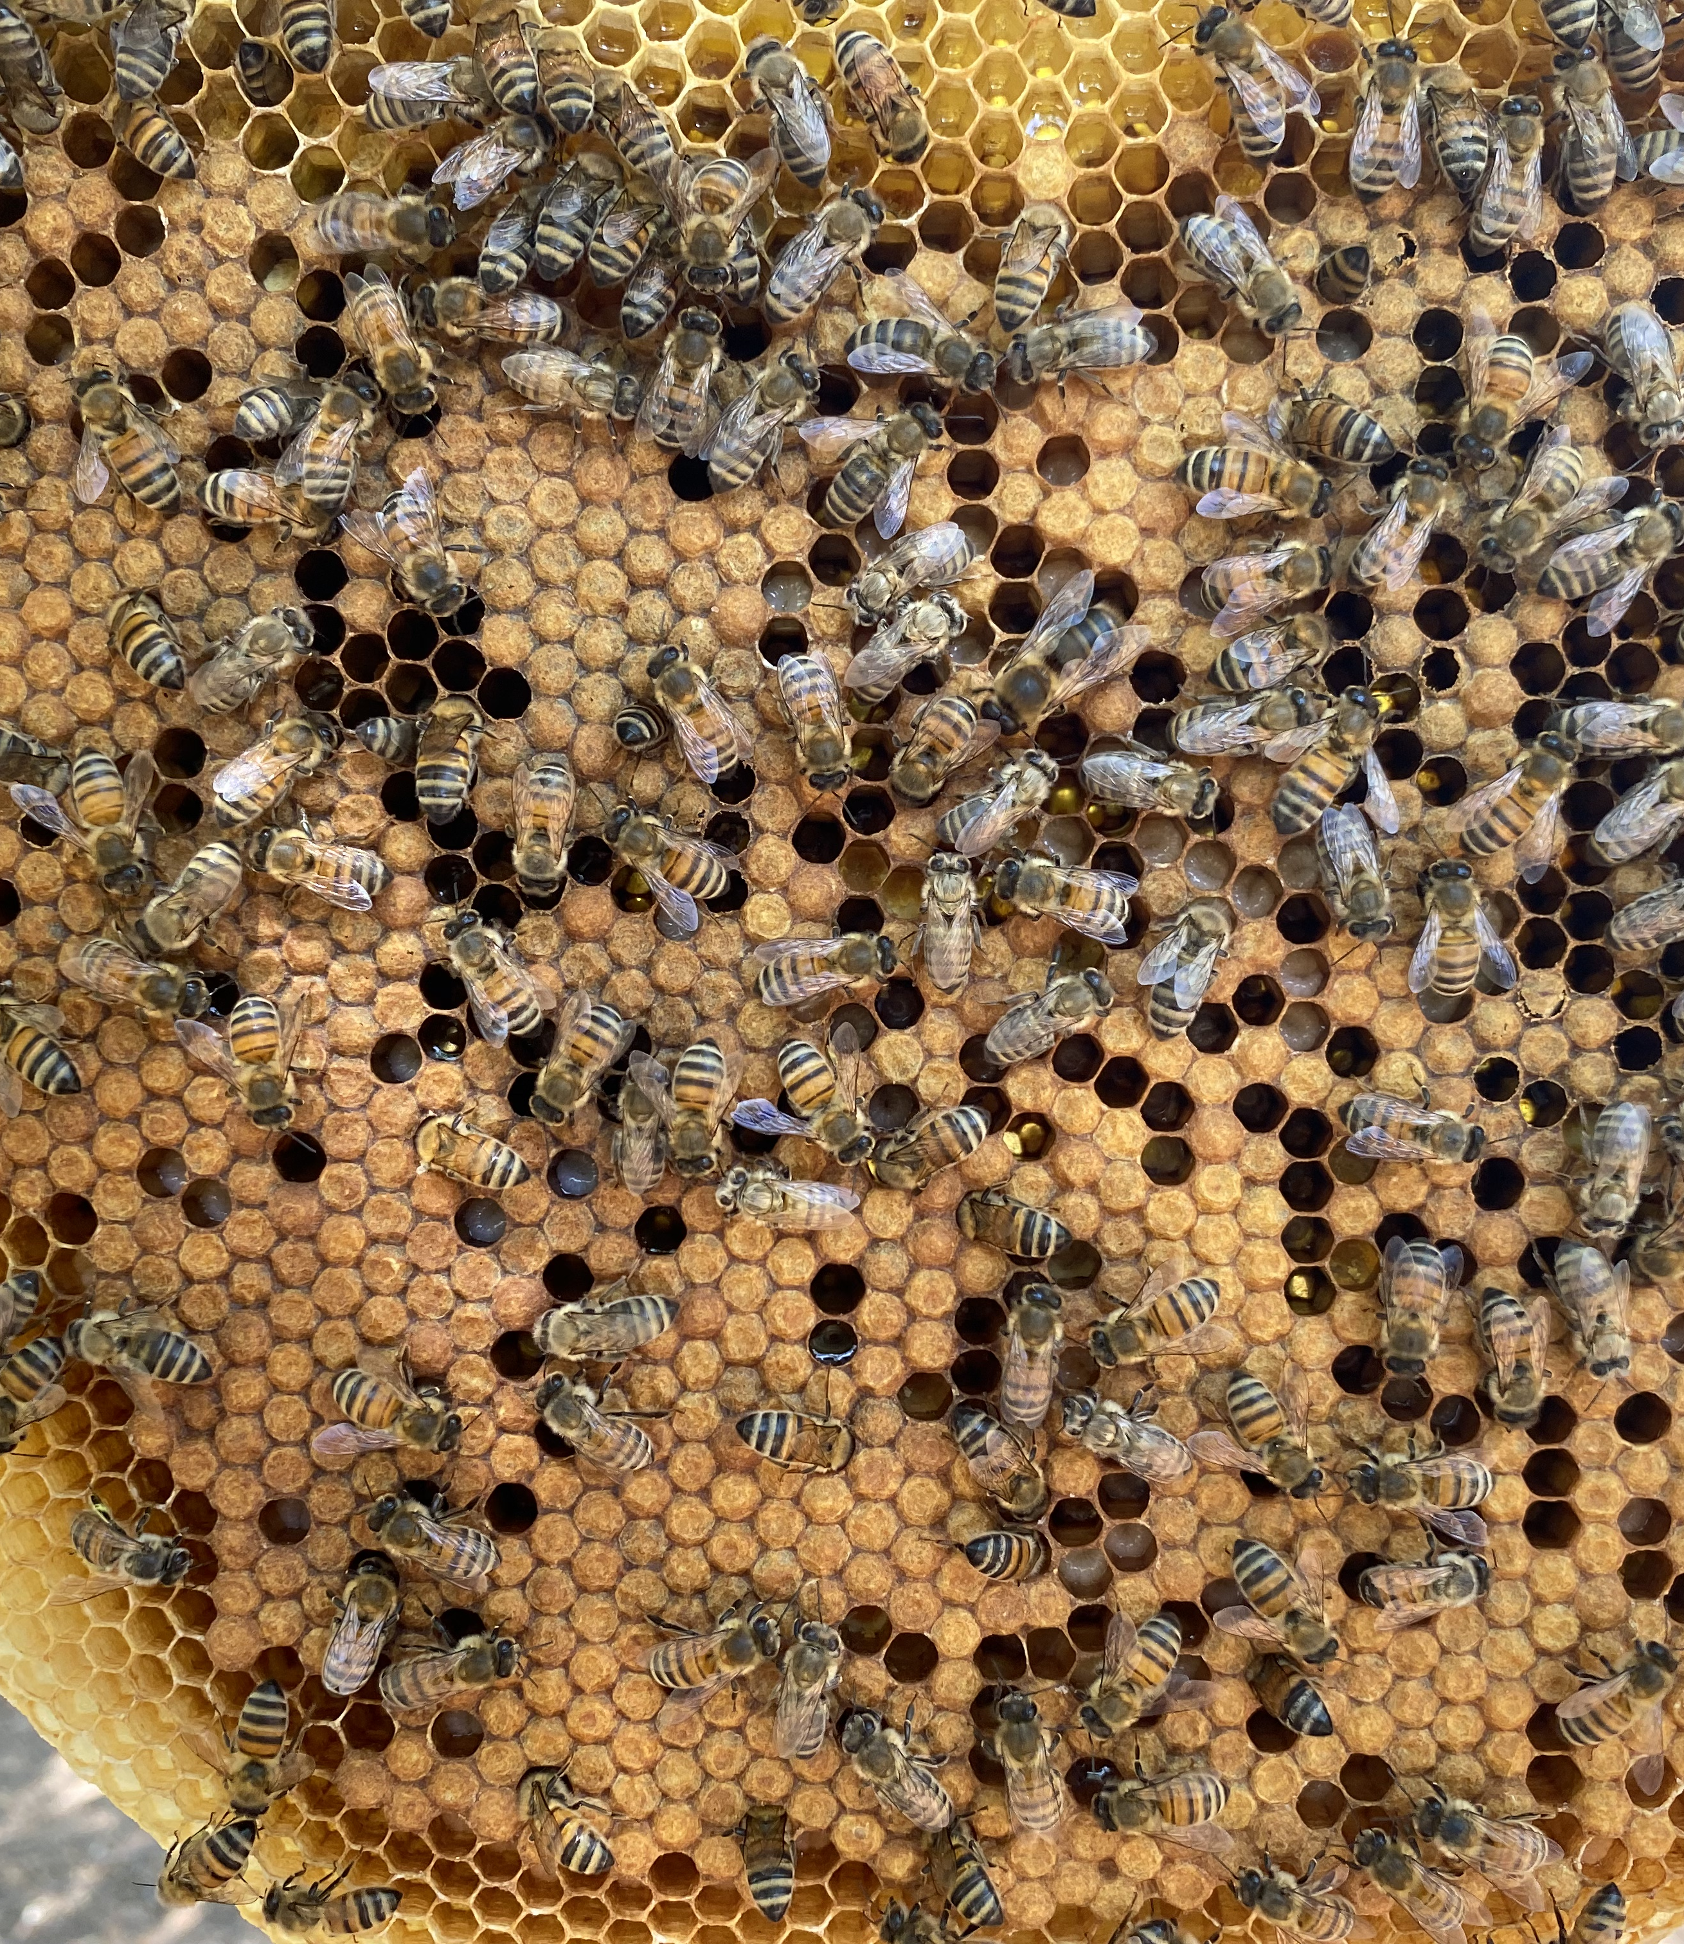
Summary
Modern IoT-based hive monitoring systems are growing in popularity
Current machine learning and data analytic methods have the potential to aid in understanding the volume of monitoring data
In this initial work, we showed the signal detrending can be used to determine a colonies foraging force, wintering consumption and robbing acquisition.
We also demonstrate some limitations in current systems/analysis (e.g. scales do not appear to be temperature compensated)

Slide 20
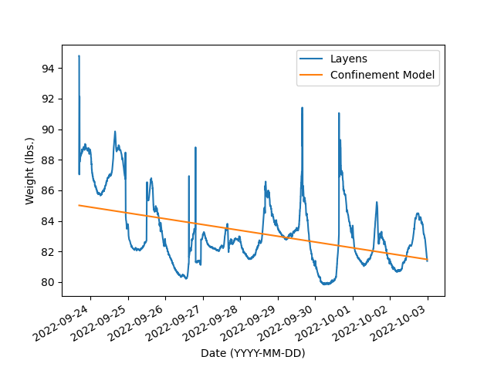
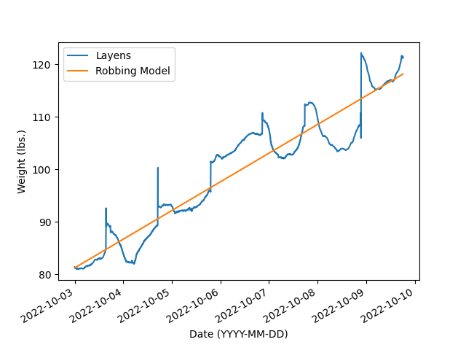
Honey Consumption and Robbing Weight Changes
Consumption during confinement: -0.38 lbs / day
Acquisition during robbing event: 5.46lbs / day

Slide 21
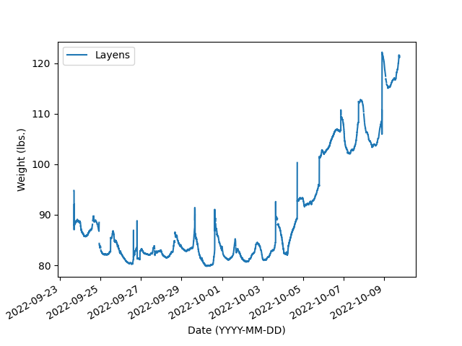
Hive Weight: Initial Analysis
Confined due to weather
Robbing event
Two+ weeks of weight data from Layens hive
Two significant events:
Confined consumption rate: 9/23 – 9/27
Robbing: 10/04 – 10/10

Slide 22
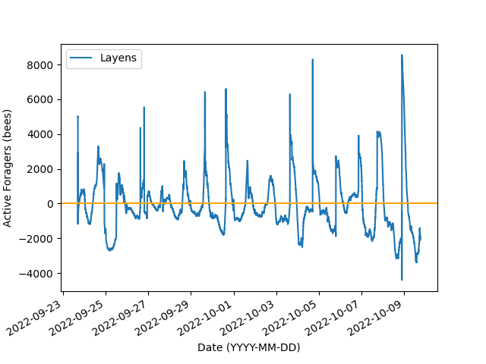
Detrended Weight Data
Overall Trend
Daily Trend

